Slide 1


Golden Copy Creation and access

Slide 2
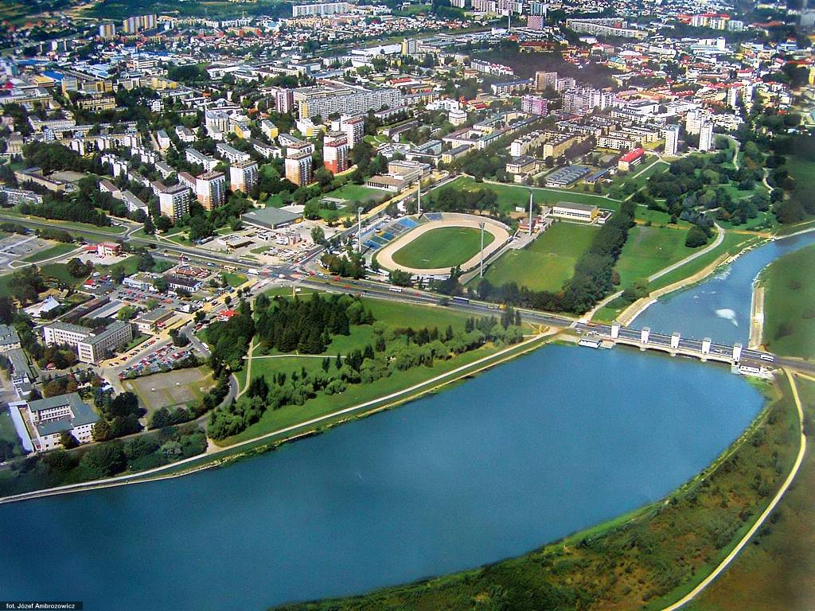



About me
Lived in Poland until 2000
Live and study in Chicago

Slide 3
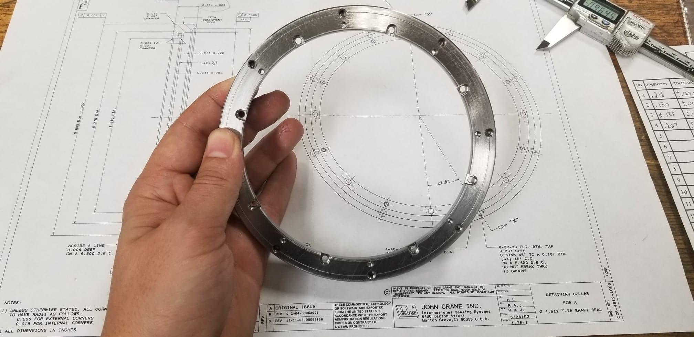
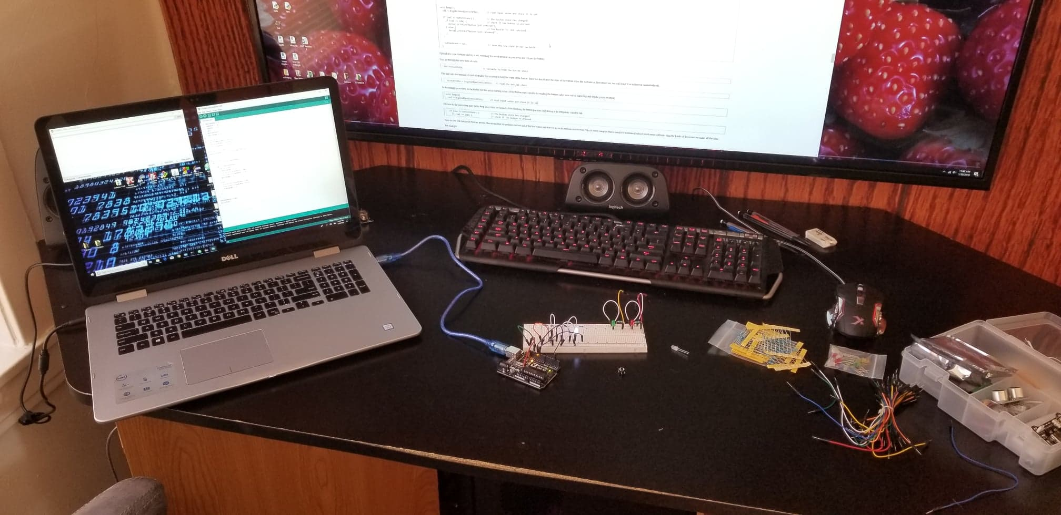
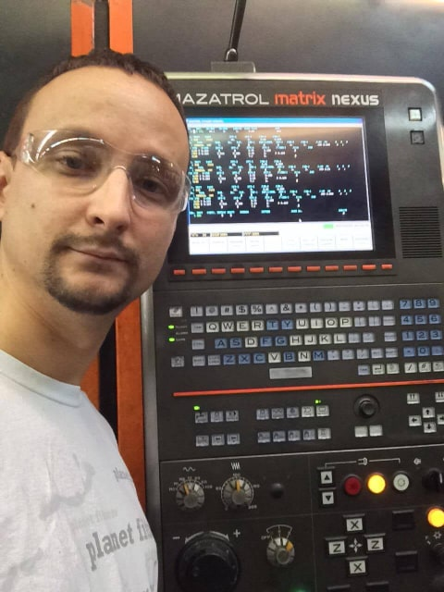
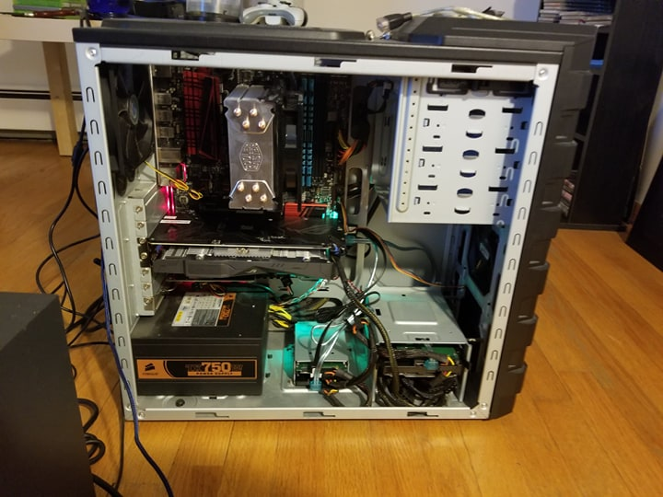
About me
CNC Machinist
Software Developer

Slide 4
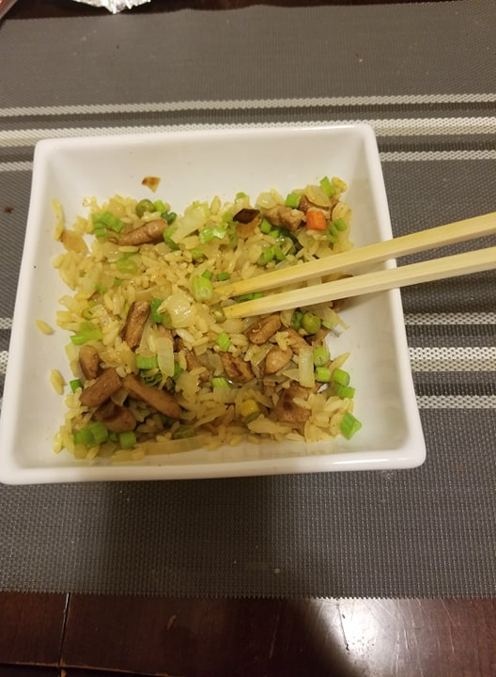

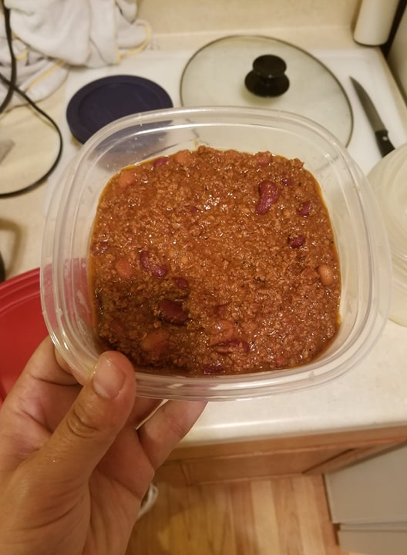

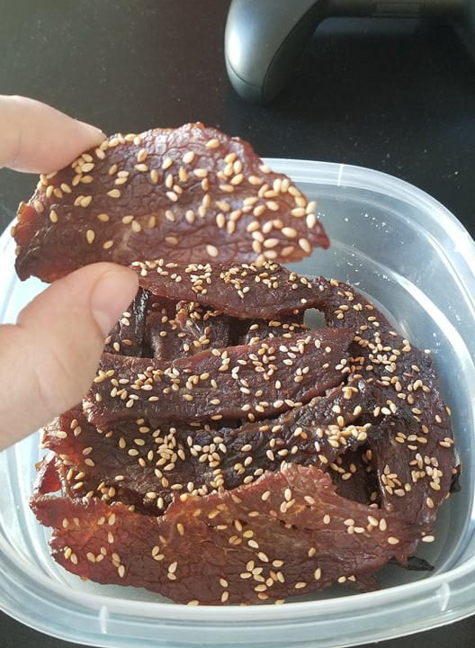
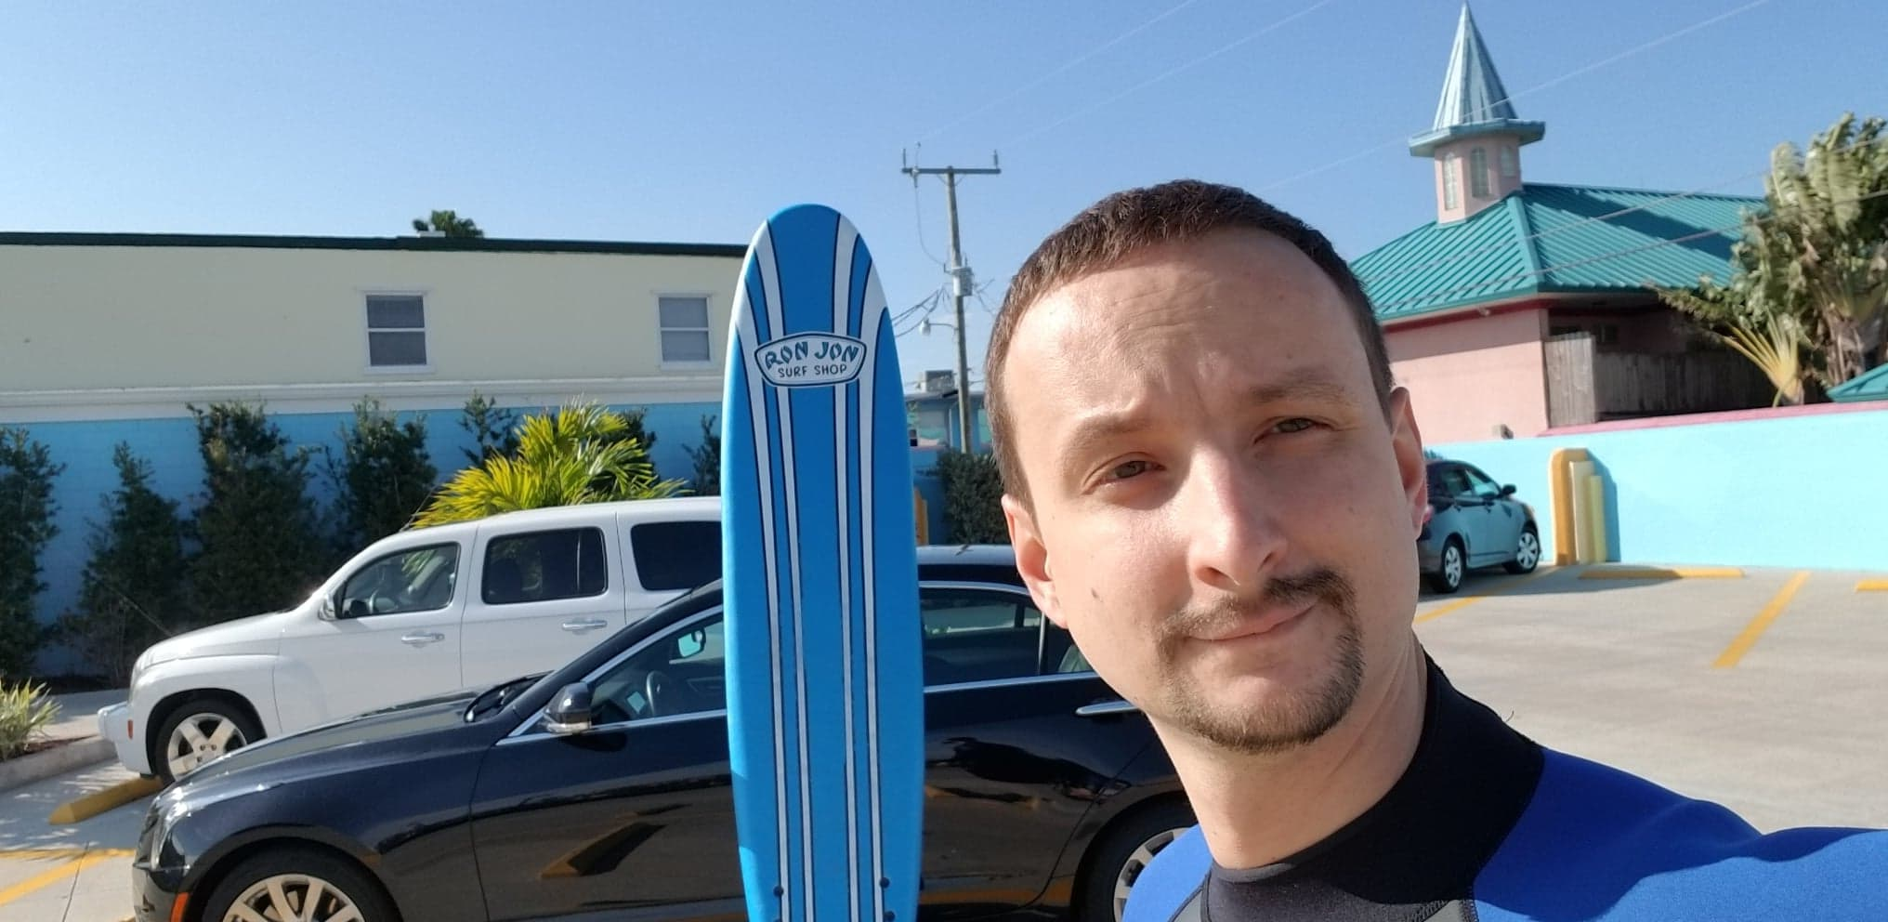
About me
Cooking
Travel

Slide 5
Agenda
Overview
Components
Review
Future Development
Prototype
Learning Experience
Cultural Experience
Conclusion

Slide 6
overview
UI
Process builder
Controller
JDBC
sqldump
Prod.
Server
MEB
SSH/FTP
DBMS

Slide 7
User Interface HTML FORMS
Accessed remotely with no need to install
Communicates with the controller using REST API
Easily upgraded with JavaScript
Drop down menus, animated buttons etc.
UI - CONTROLLER - DBMS - JDBC - PB – SQLDUMP - MEB - FT

Slide 8
controller Spring boot
Java framework that lets us build a REST API server
Server waits for GET and POST requests and calls java methods
Runs command line utilities, queries the database and manages the file system
UI - CONTROLLER - DBMS - JDBC - PB – SQLDUMP - MEB - FT

Slide 9
Database management system Mysql
SQL is a widely used query language
Well documented
MySQL is more lightweight than Oracle
Free
UI - CONTROLLER - DBMS - JDBC - PB – SQLDUMP - MEB - FT

Slide 10
Java database connectivity connector J
Java API to send SQL queries
Mimics user typed input
Based on string manipulation
Create accounts, give access, query database, etc.
Can be tedious
UI - CONTROLLER - DBMS - JDBC - PB – SQLDUMP - MEB - FT

Slide 11
Process builder
Java class to create operating system processes
Lets a java program run other programs
Used to run command line utilities
UI - CONTROLLER - DBMS - JDBC - PB – SQLDUMP - MEB - FT

Slide 12
sqldump
Command line utility to automate SQL queries
Mimics user typed output
Used to create copies of DB’s with different names
Slower than MEB
UI - CONTROLLER - DBMS - JDBC - PB – SQLDUMP - MEB - FT

Slide 13
Mysql enterprise backup
Command line utility to create a DB backup
Partial, compressed, hot backup
Better than copying files or sqldump
No renaming of DB’s
UI - CONTROLLER - DBMS - JDBC - PB – SQLDUMP - MEB - FT

Slide 14
File transfer ssh protocol
Can execute commands on other servers remotely
Recommended by MEB documentation
Built in Windows 10 command line
An alternative is FTP
UI - CONTROLLER - DBMS - JDBC - PB – SQLDUMP - MEB - FT

Slide 15
review
UI
HTTP Forms
Process builder
Controller
Spring
JDBC
Conn. J
sqldump
Prod.
Server
MEB
SSH/FTP
DBMS
MySQL

Slide 16
Future development
GC file transfer research and coding
New ownership and version encoding
- sqldump code, based on current research
- controller modification
UI visual appeal and new features

Slide 17
PROTOTYPE

Slide 18
Learning experience
Languages:
- HTML and SQL
API’s:
- REST and Connector J
Classes:
- Process Builder and File
Misc.:
- Spring Boot framework
- MySQL Enterprise Backup
- MySQL file structure

Slide 19




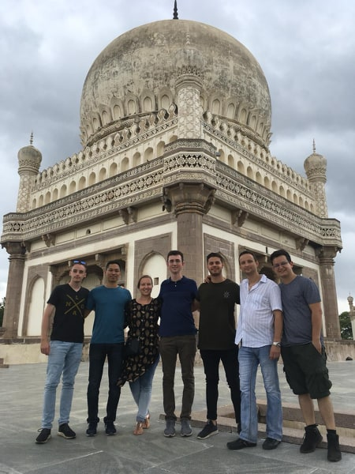



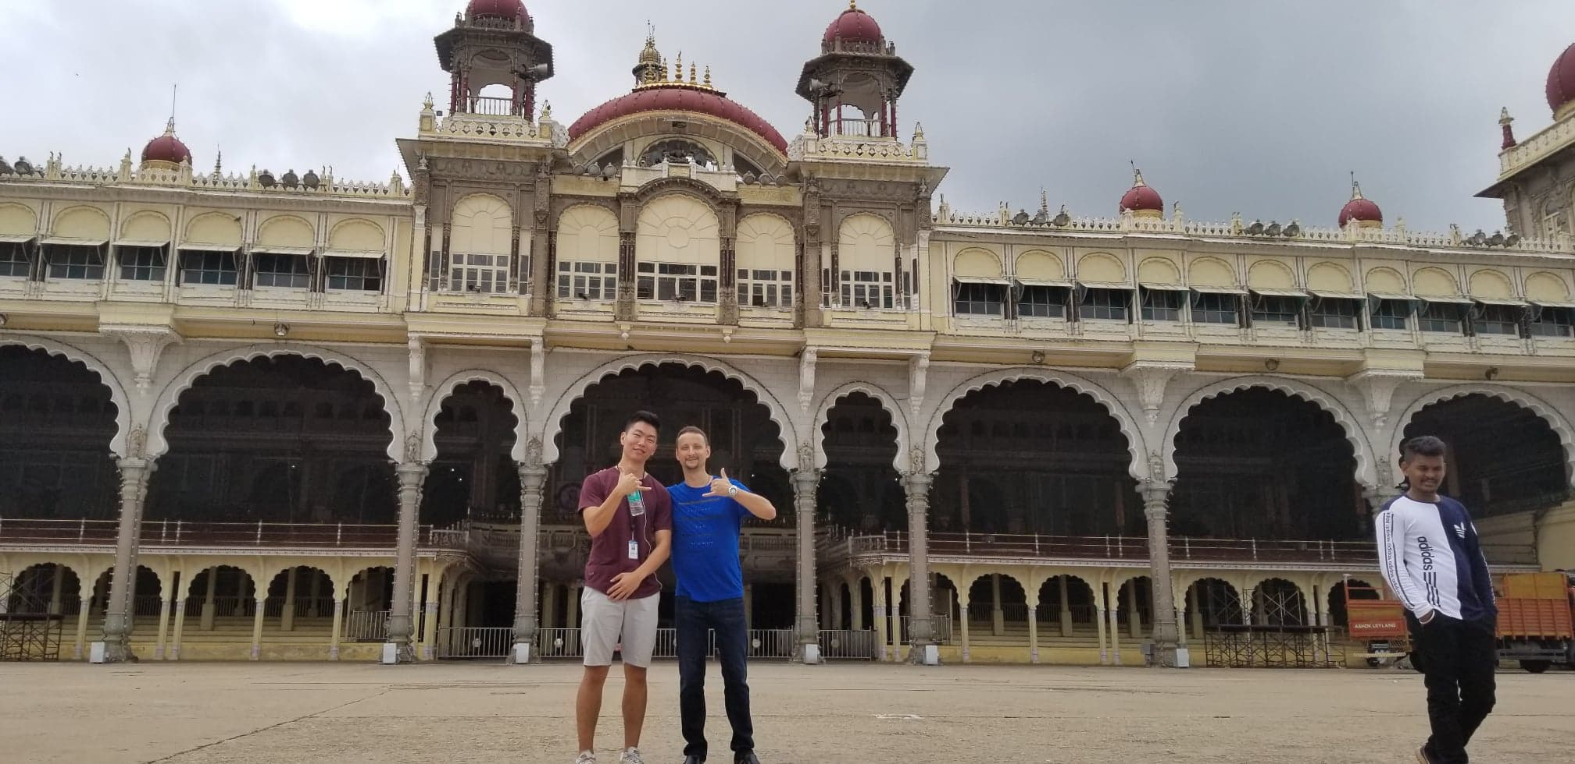

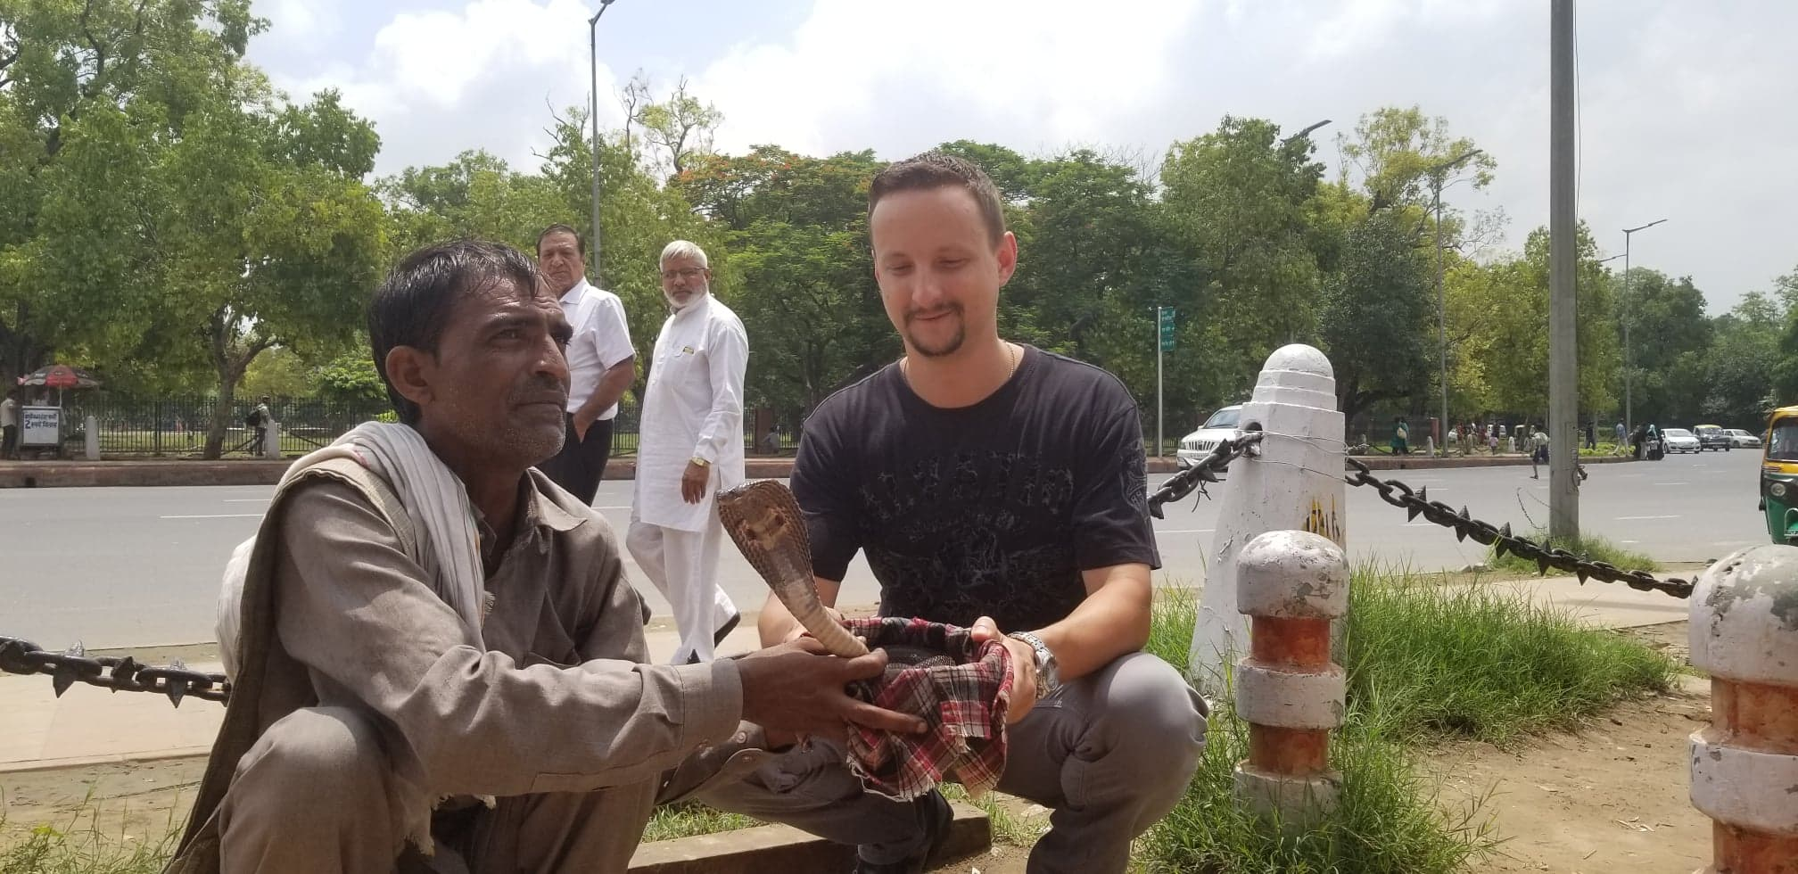

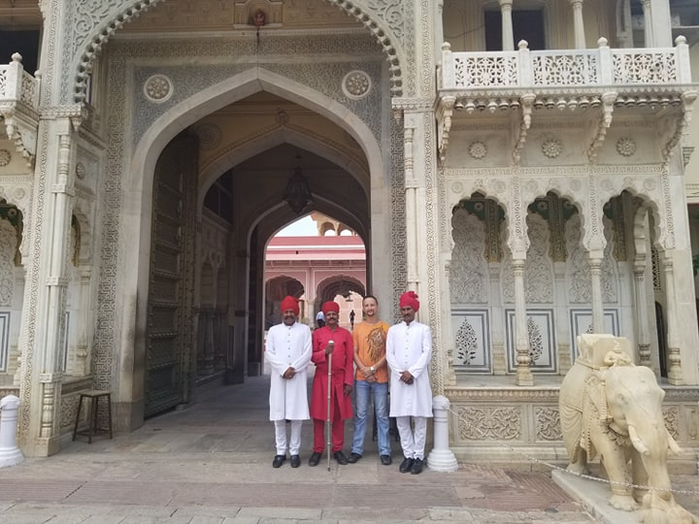


cultural experience
Hampi
Mumbai
Kerala
Goa
Hyderabad
Puducherry
Auroville
Chennai
Mysore
Varanasi
Delhi
Agra
Jaipur
Andaman
Jaisalmer

Slide 20
conclusion
Learned many new technologies
Hope to be of value to Infosys
Met many great people
Experienced culture through food and travel
Had a lot of fun and made great memories

